Slide 1
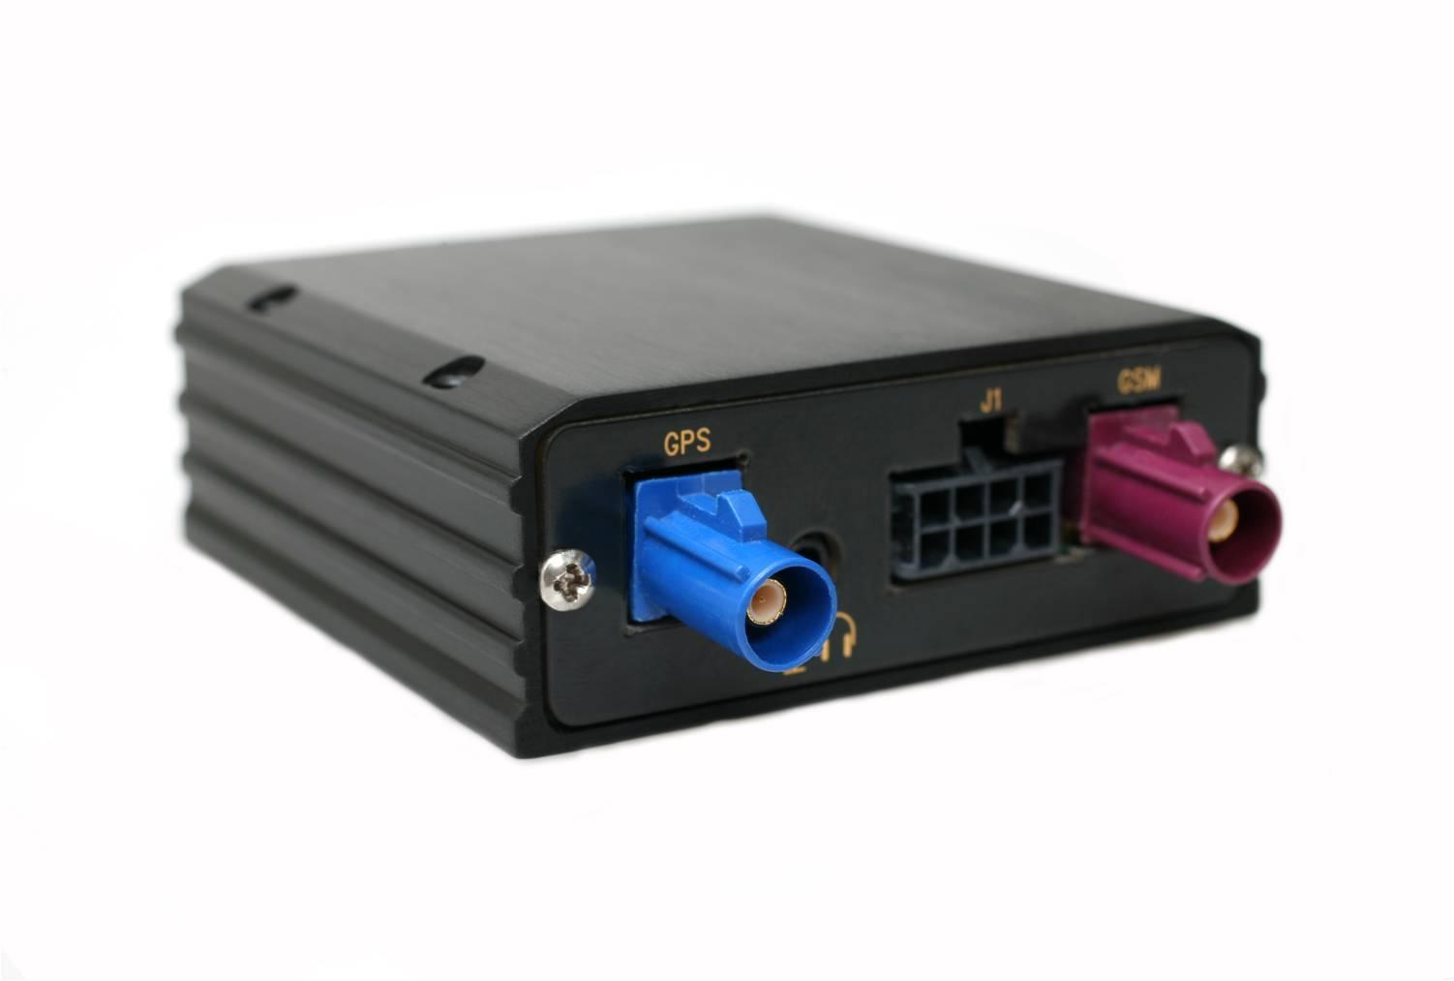
AVL Hardware
Onboard the Train:
GPS (Global Positioning System) Unit
Reports location of train in realtime
Communicates with onboard Master PC
Image source: Numerex

Slide 2
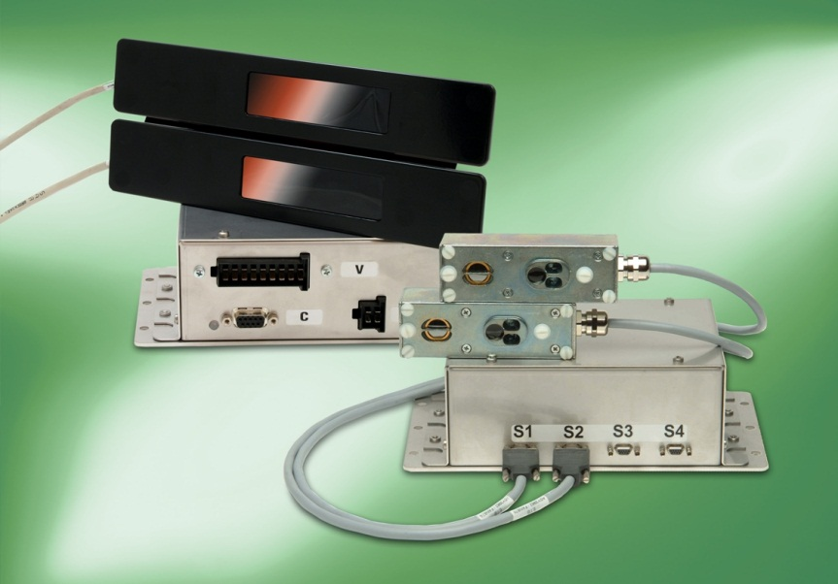
APC Hardware
Onboard the Train:
Bi Directional Infrared Sensor Bars
Accurately records occupancy by tracking incoming and outgoing passengers
Communicates with onboard Master PC
Image source: INIT systems

Slide 3
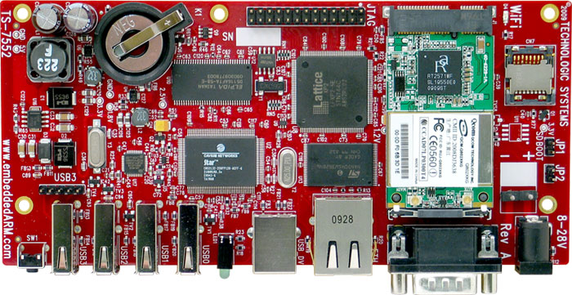
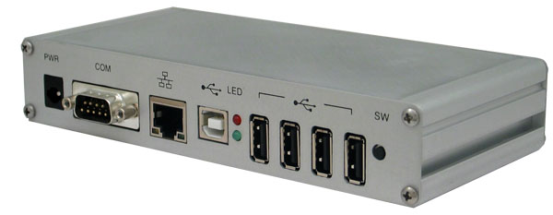
Onboard Master PC
Underlying Hardware:
ARM SBC
Runs Linux (free!)
Easily Adaptable
802.11 / GPRS Capable
Designed to receive input from many onboard AVL units and APC units
Serial RS-232 & RS-485
Long range RF
USB
Image sources: Technologic Systems

Slide 4
Server Architecture
X86 based Intel processors
Database server
Large disk size
Redundancy & Backups
Optimization & Decision server
Web App Server(s)
Clustered & Load Balanced w/ HA

Slide 5
Physical Servers vs. Virtual Servers
Virtualization allows for longevity and ease of maintenance versus a physical server.
However, transit organizations may want to have a physical box on site for local management.
This flexibility allows for solutions at multiple price points.
Local physical servers
Local virtual servers
Remote servers

